Slide 1
Supervised Learning and k Nearest Neighbors
Md. Manowarul Islam
Associate Professor
Dept. of CSE
Jagannath University.

Slide 2
Supervised learning and classification
Given: dataset of instances with known categories
Goal: using the “knowledge” in the dataset, classify a given instance
  predict the category of the given instance that is rationally consistent with the dataset

Slide 3
Classifiers
X1
X2
feature
values
X3
Y
…
Classifier
category
Xn
DB
collection of instances
with known categories

Slide 4
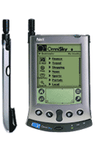
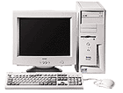




Instance-based Learning
Its very similar to a
Desktop!!

Slide 5
Algorithms
K Nearest Neighbors (kNN)
Naïve-Bayes
Decision trees
Many others (support vector machines, neural networks, genetic algorithms, etc)

Slide 6
K - Nearest Neighbors
For a given instance T, get the top k dataset instances that are “nearest” to T
  Select a reasonable distance measure
Inspect the category of these k instances, choose the category C that represent the most instances
Conclude that T belongs to category C

Slide 7
Example 1
Determining decision on scholarship application based on the following features:
  Household income (annual income in millions of pesos)
  Number of siblings in family
  High school grade (on a QPI scale of 1.0 – 4.0)
Intuition (reflected on data set): award scholarships to high-performers and to those with financial need

Slide 8

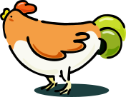




Nearest Neighbor Classifiers
Basic idea:
  If it walks like a duck, quacks like a duck, then it’s probably a duck
Compute Distance
Test Record
Training Records
Choose k of the “nearest” records

Slide 9

Definition of Nearest Neighbor
K-nearest neighbors of a record x are data points that have the k smallest distance to x

Slide 10
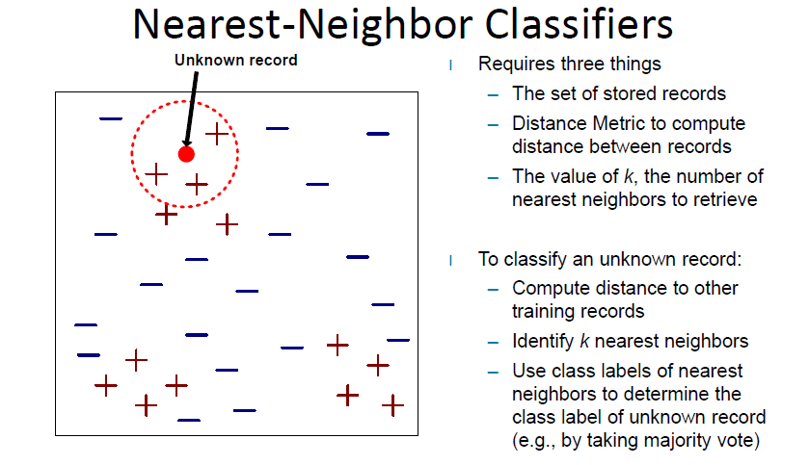

Slide 11
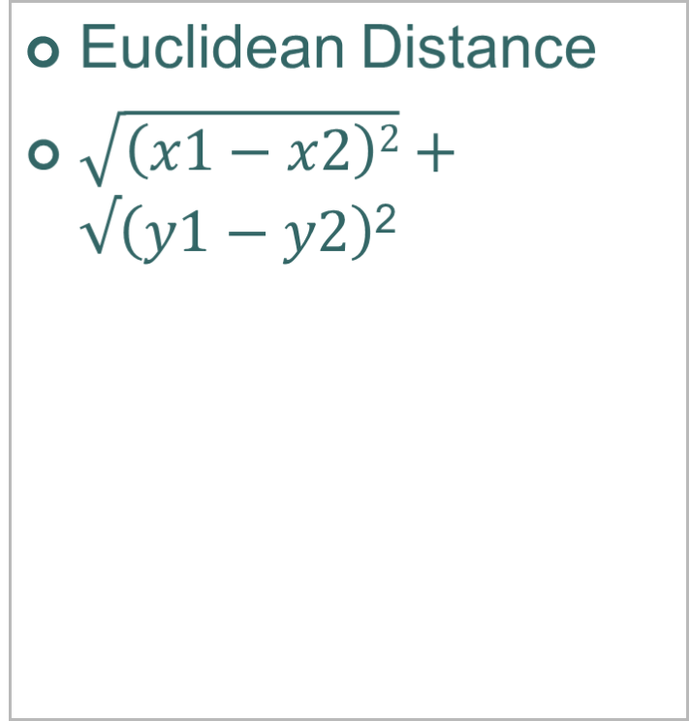

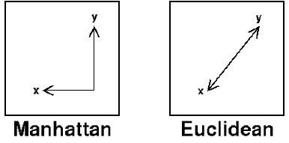
Destance
Manhattan Distance
|X1-X2| + |Y1-Y2|

Slide 12
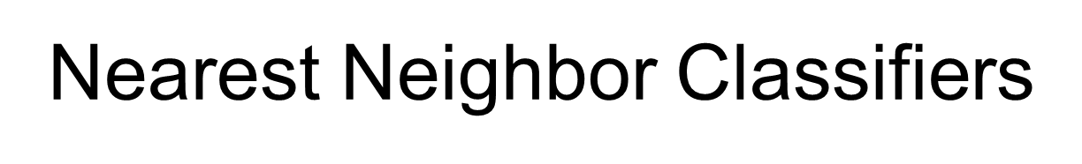
Select 5 Nearest Neighbors
as Value of K=5 by Taking their
Euclidean Disances

Slide 13

Decide if majority of Instances over a given
value of K Here, K=5.

Slide 14
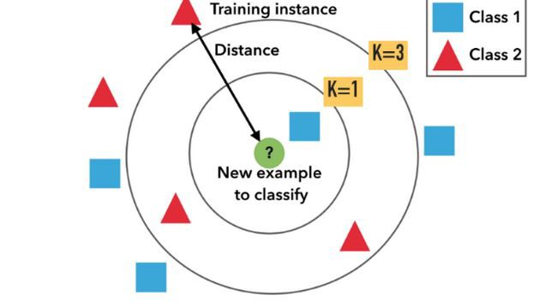

Slide 16
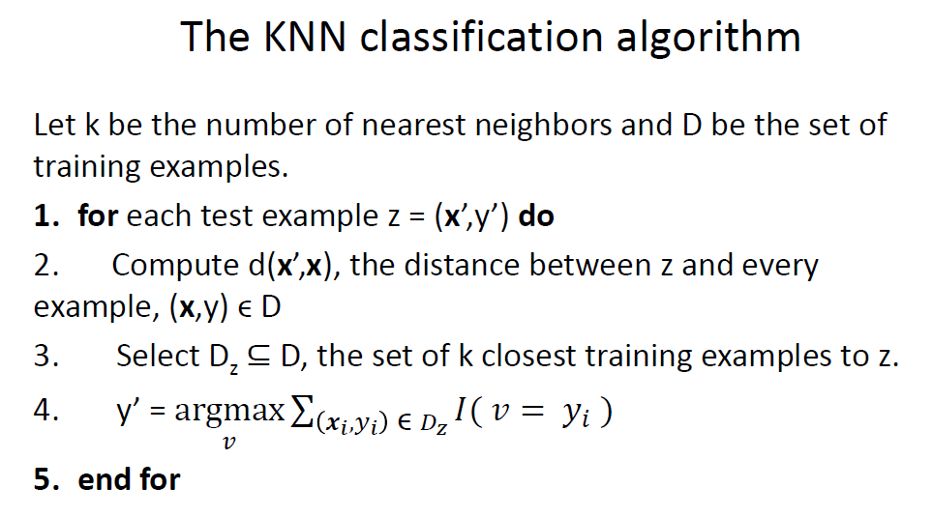

Slide 17
Points | X1 (Acid Durability ) | X2(strength) | Y=Classification
P1 | 7 | 7 | BAD
P2 | 7 | 4 | BAD
P3 | 3 | 4 | GOOD
P4 | 1 | 4 | GOOD

Slide 18
Points | X1(Acid Durability) | X2(Strength) | Y(Classification)
P1 | 7 | 7 | BAD
P2 | 7 | 4 | BAD
P3 | 3 | 4 | GOOD
P4 | 1 | 4 | GOOD
P5 | 3 | 7 | ?

Slide 19
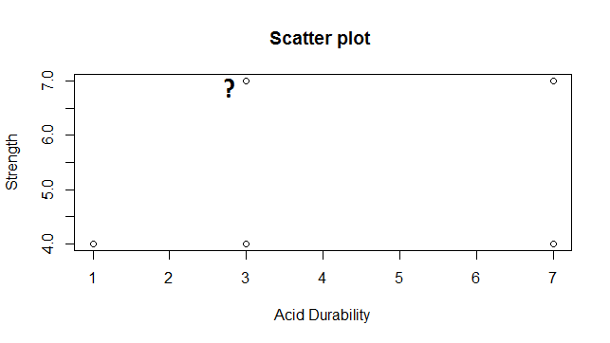

Slide 20
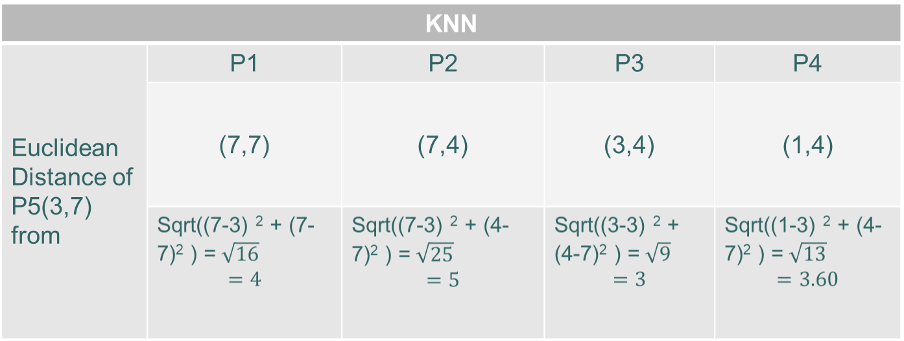


Slide 21
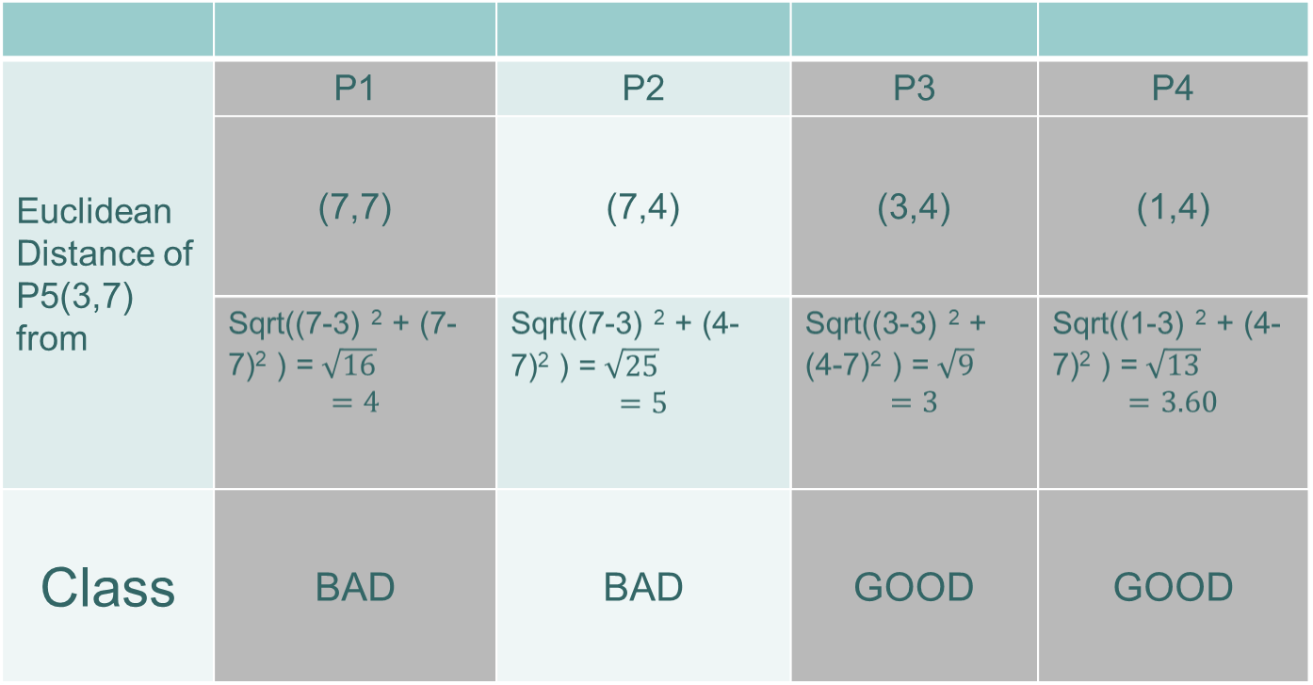
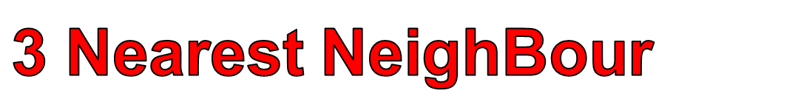

Slide 22

Points | X1(Durability) | X2(Strength) | Y(Classification)
P1 | 7 | 7 | BAD
P2 | 7 | 4 | BAD
P3 | 3 | 4 | GOOD
P4 | 1 | 4 | GOOD
P5 | 3 | 7 | GOOD

Slide 23
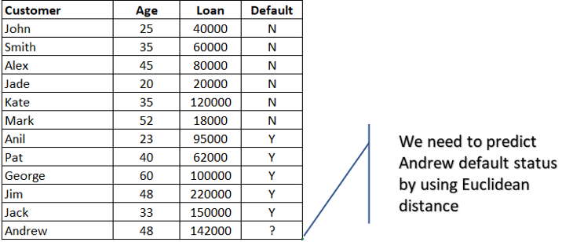
Example-2

Slide 24
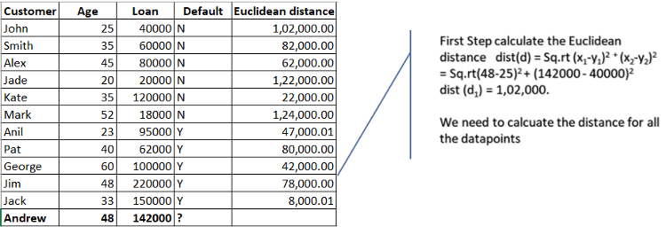
Example-2

Slide 25
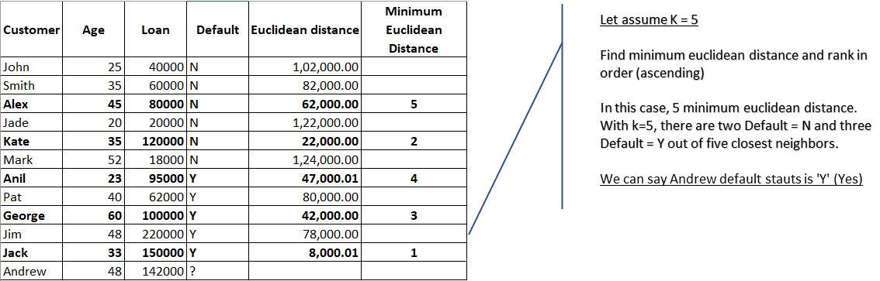
Example-2

Slide 26
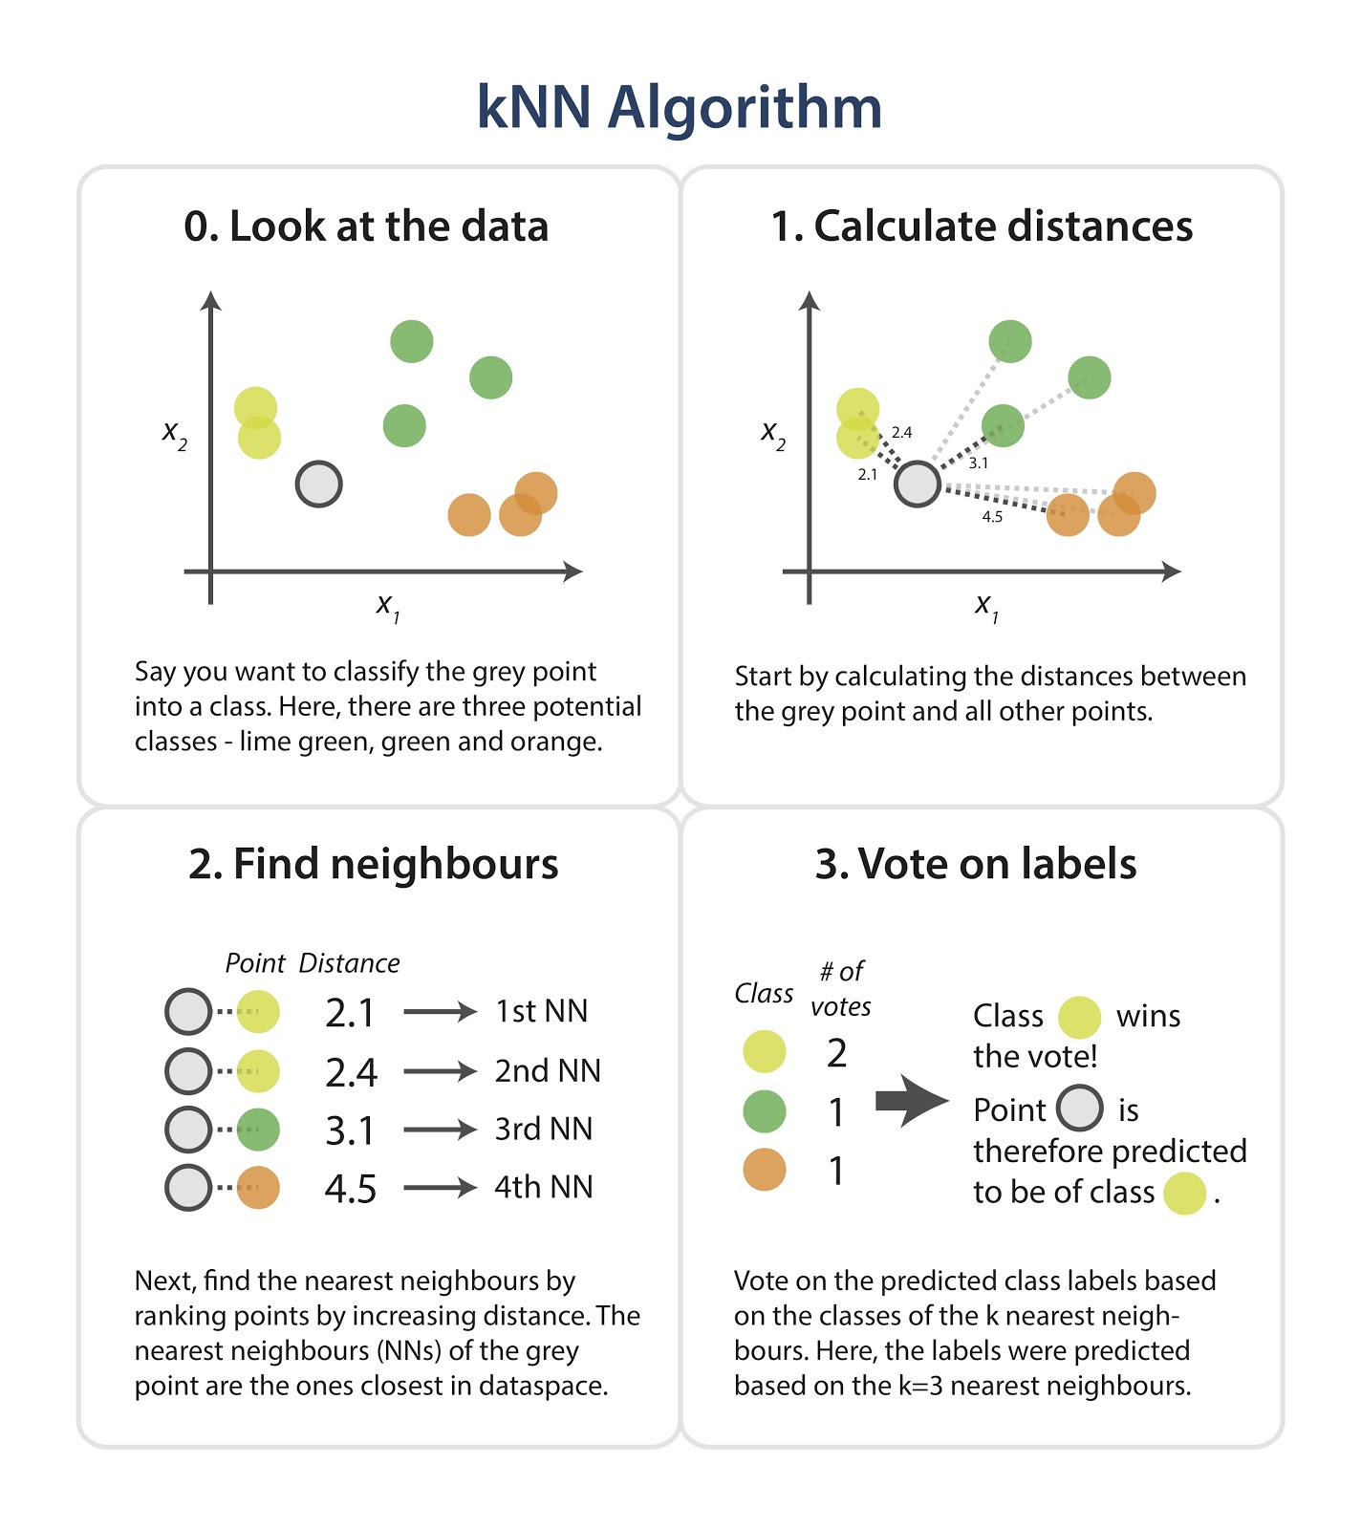
Example-3

Slide 27
Example-3

Slide 28
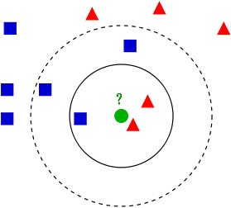
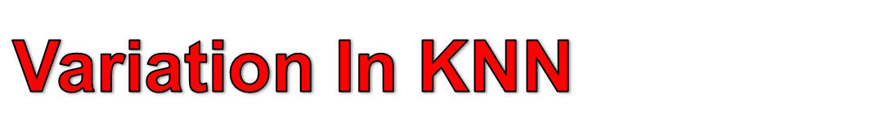

Slide 29
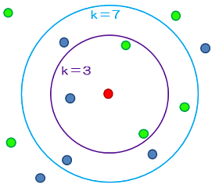
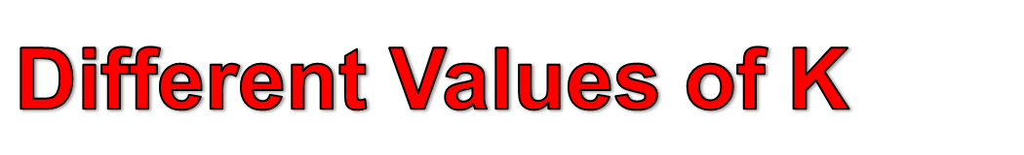

Slide 30
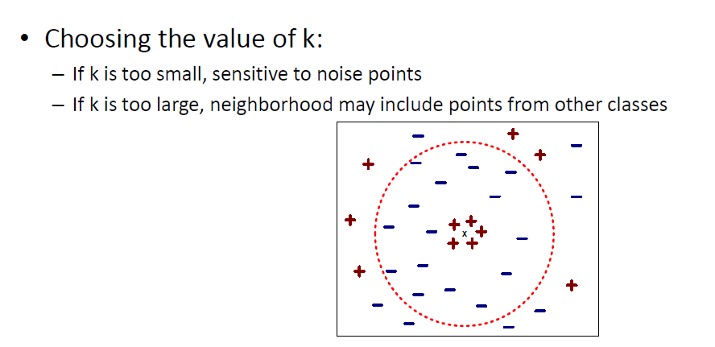

Slide 31
